Slide 1
Applied Machine Learning and Data Mining
Week 7: Supervised Vs Unsupervised Learning
Dr. Alaa Mohasseb

Slide 2
Last Week
Learn what is Data Analysis
Gain an understanding of the different types Data Analysis
Understand what is Data Visualization
Learn about the types of data visualization charts
Identify what makes a good visualization

Slide 3
Outline for Today
Identify how to select the appropriate modelling technique.
Understand the difference between supervised and unsupervised learning.
Learn the different types of supervised and unsupervised learning algorithms.

Slide 4

Modelling
Business understanding
What modelling techniques should be applied?
Deployment
Data Understanding
Data Mining Process
Evaluation
Data
preparation
Modelling

Slide 5

Tasks of Modelling
Select modelling techniques
Generate test design
Build model
Assess model

Slide 6
Supervised vs Unsupervised Learning

Slide 7
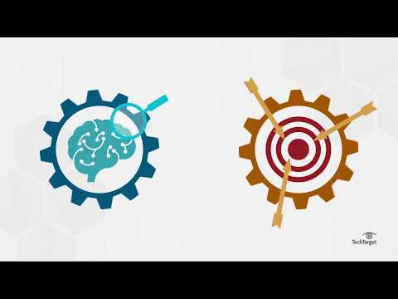
Watch & Discuss Activity
Do you think the following utilises supervised or unsupervised learning? Why do you think so?
Personalised marketing
Anomaly detection
Recommendation systems
Sales performance prediction
Customer segmentation

Slide 8
Supervised Learning
The training data (observations, measurements, etc.) are accompanied by labels indicating the class of the observations.
New data is classified based on the training set
Labelled date:
01.
Categorical data
02.
Numerical data

Slide 9





Supervised Learning
Supervisor
Output
Training Data Set
Desired Output
Input Raw Data
Algorithm
Processing
Source adapted from: https://bigdata-madesimple.com/wp-content/uploads/2018/02/Machine-Learning-Explained1.png

Slide 10
Why Supervised Learning?
Most common type of learning method
Easy to understand
Performance optimisation
Solve various types of real-world problems

Slide 11
Disadvantages of Supervised Learning
It cannot create labels of its own.
New data has to be from the given classes only

Slide 12
Types of Supervised Learning
Classification
Regression
Source adapted from: 031519_0622_Supervisedv5.png

Slide 13


Classification
Models that classify data under different classes.
Classification Types:
Apple
Not Apple
01.
Binary classification
02.
Multiclass classification

Slide 14
Multiclass Classification
Sports
Technology
Class 1
News
Politics
Class 2
Entertainment
Labels
Class 3
Positive
Class n
Sentiments
Negative
Neutral

Slide 15
Binary Classification
Spam
Email
Not Spam
Class 1
Labels
Class 2
Positive
Reviews
Negative

Slide 16



Classification Algorithms
Naive Bayes
Random
Forest
Support Vector
Machine
K-nearest neighbors
Decision Tree

Slide 17



Example of Classification
Classification algorithms could be applied to several real-world applications such as:
01.
Health
02.
Education
03.
Retail

Slide 18
Regression
01.
02.
Models that predict a continuous value
Statistical method

Slide 19
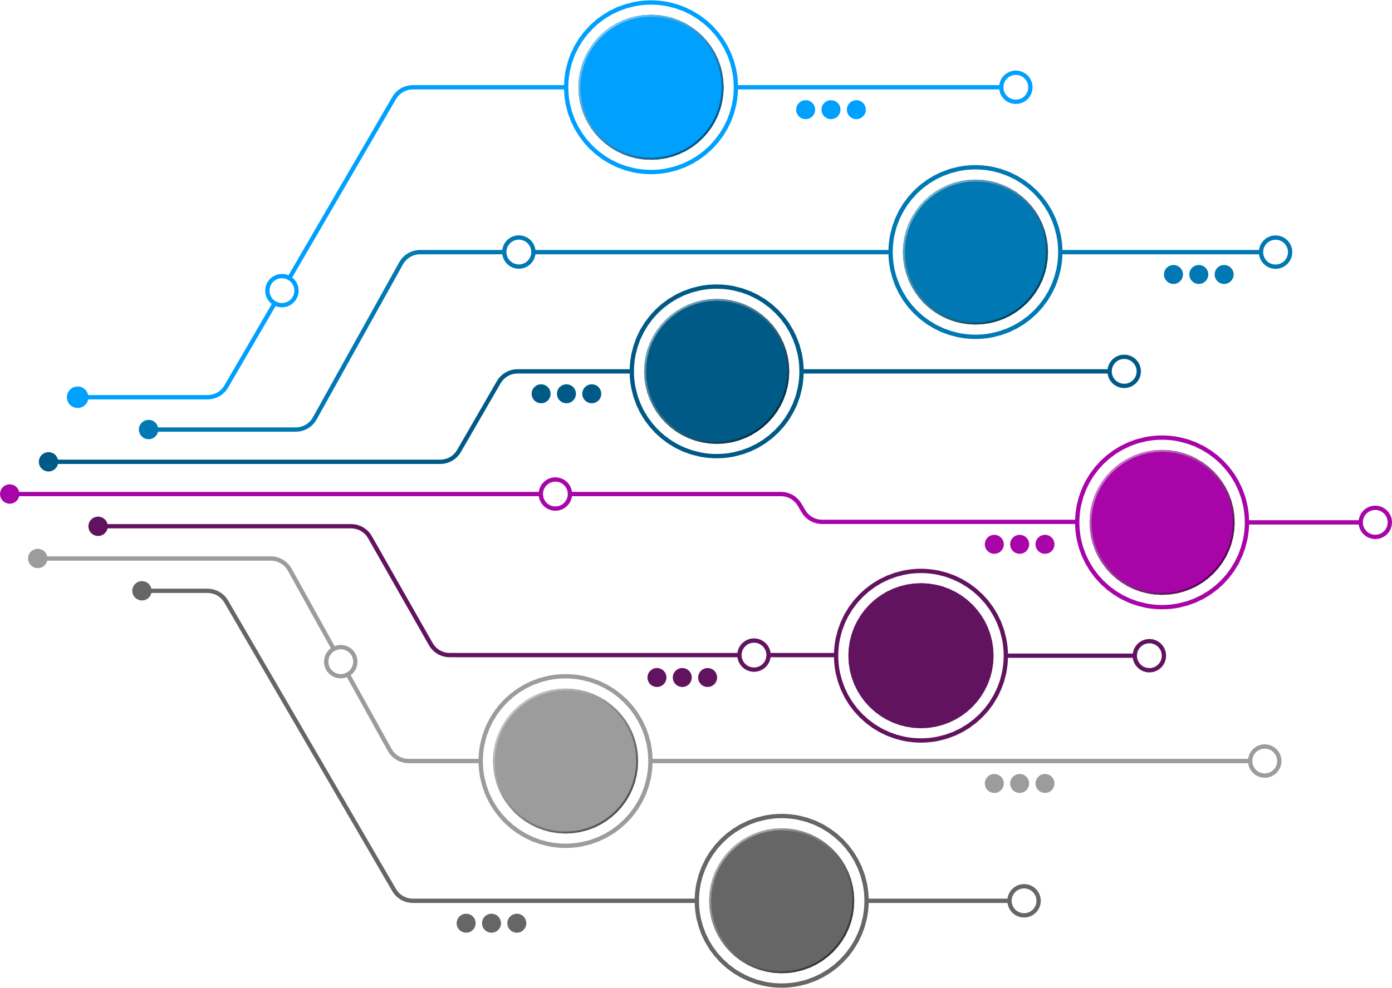
Regression Algorithms
Simple Linear Regression
Multiple Linear Regression
Polynomial Regression
Logistic Regression
Support Vector Regression
Decision Tree Regression
Random Forest Regression

Slide 20


Example of Regression Tasks
Regression algorithms could be applied to several real-world applications such as:
01.
Finance
02.
Social Media

Slide 21

Unsupervised Learning
Is a type of machine learning algorithm used to draw inferences from datasets consisting of input data without labelled responses.
It mainly deals with the unlabelled data.

Slide 22
Unsupervised Learning
Output
Input Raw Data
Unknown Output No Training Data Set
?
Interpretation
Algorithm
Processing
Source adapted from: https://bigdata-madesimple.com/wp-content/uploads/2018/02/Machine-Learning-Explained1.png

Slide 23
Why Unsupervised Learning?
Finds all kinds of unknown patterns in data.
It takes place in real time.
It is easier to get unlabelled data from a computer than labelled data, which needs manual intervention.

Slide 24
Disadvantages of Unsupervised Learning
The result might be less accurate.
It is a time-consuming process.

Slide 25
Types of Unsupervised Learning
1
0,8
0,6
0,4
0,2
0
0,2
0,4
0,6
0,8
1
Clustering
Association Rules
Source adapted from: association-rules.png
Source adapted from: Screenshot-2019-03-22-at-18.14.38-1024x973.png

Slide 26
Clustering
The task of grouping similar sets of objects together
Clustering
Scattered Population
Clustered Population
Source adapted from: https://bigdataanalyticsnews.com/wp-content/uploads/2020/10/cluster-machine-learning-1024x394.jpg

Slide 27
Cluster Algorithms
K-means
DBSCAN (Density-based Spatial Clustering of Applications with Noise)
Hierarchical clustering

Slide 28


Example of Clustering
Cluster algorithms could be applied to several real-world applications such as:
01.
Health
02.
Finance
03.
Retail

Slide 29

Association Rules
Discover rules that describe large portions of your data
A common form of this type of application is called ‘market basket analysis’

Slide 30
Association Rule Algorithms
01.
02.
03.
Eclat algorithm (Equivalence Class Transformation)
Apriori algorithm
FP-growth algorithm (frequent pattern)

Slide 31
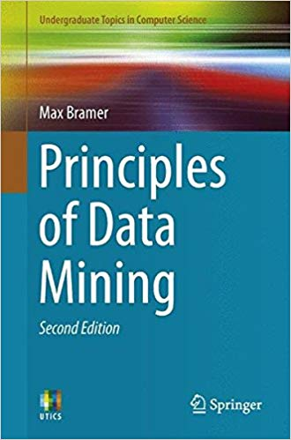
Reading for this week
1.4 - Labelled and Unlabelled Data
1.5 - Supervised Learning: Classification
1.6 - Supervised Learning: Numerical Prediction
1.7 - Unsupervised Learning: Association Rules
1.8 - Unsupervised Learning: Clustering
link

